Slide 1
The Network Layer

Slide 2
Network Layer Design Issues
Store-and-Forward Packet Switching
Services Provided to the Transport Layer
Implementation of Connectionless Service
Implementation of Connection-Oriented Service
Comparison of Virtual-Circuit and Datagram Subnets

Slide 3

Store-and-Forward Packet Switching
fig 5-1
The environment of the network layer protocols.

Slide 4
Services Provided to the Transport Layer
The Network Layer services have been designed with the following goal in mind:
  The services should be independent of the router technology.
  The transport layer should be shielded from the number, type, and topology of the router present.
  The network address made available to the transport layer should use a uniform numbering plan, even across LANs and WANs.

Slide 5
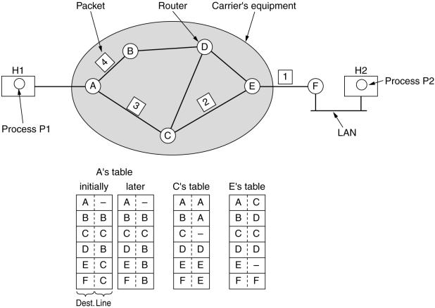
Implementation of Connectionless Service
Routing within a diagram subnet.

Slide 6

Implementation of Connection-Oriented Service
Routing within a virtual-circuit subnet.

Slide 7

Comparison of Virtual-Circuit and Datagram Subnets
5-4

Slide 8
Routing Algorithms
The Optimality Principle
Shortest Path Routing
Flooding
Distance Vector Routing
Link State Routing
Hierarchical Routing
Broadcast Routing
Multicast Routing
Routing for Mobile Hosts
Routing in Ad Hoc Networks

Slide 9
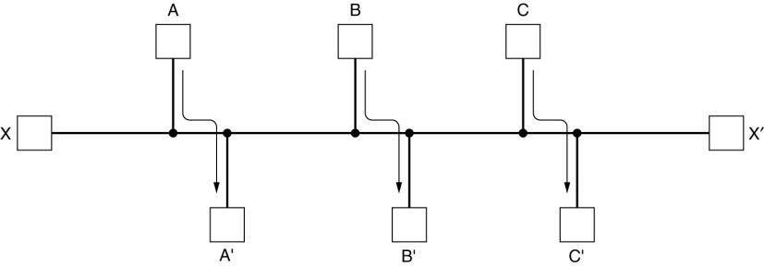
Routing Algorithms (2)
Conflict between fairness and optimality.

Slide 10
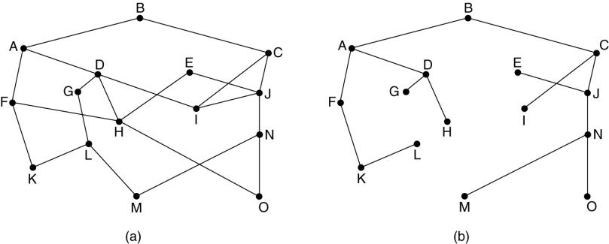
The Optimality Principle
(a) A subnet. (b) A sink tree for router B.

Slide 11
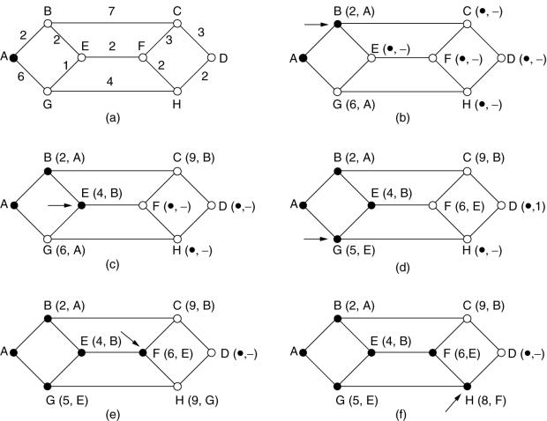
Shortest Path Routing
The first 5 steps used in computing the shortest path from A to D.
The arrows indicate the working node.

Slide 12
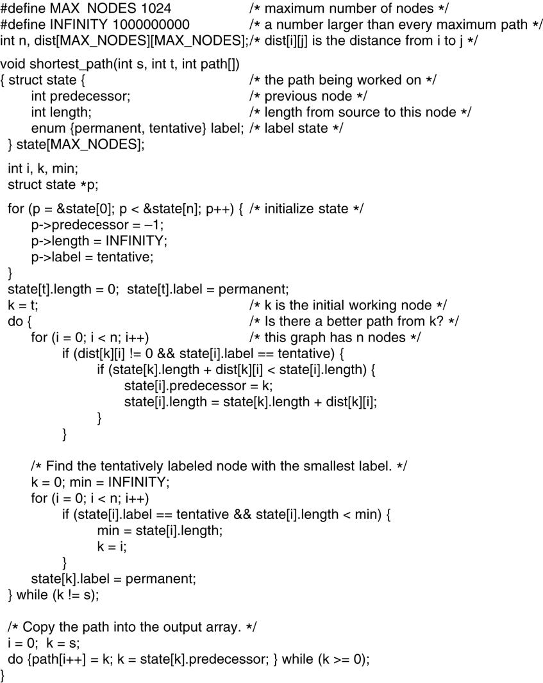
Flooding
5-8 top
Dijkstra's algorithm to compute the shortest path through a graph.

Slide 13
Flooding (2)
5-8 bottom
Dijkstra's algorithm to compute the shortest path through a graph.

Slide 14
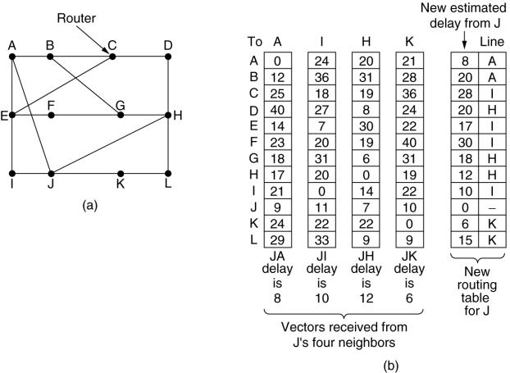
Distance Vector Routing
(a) A subnet. (b) Input from A, I, H, K, and the new
routing table for J.

Slide 15
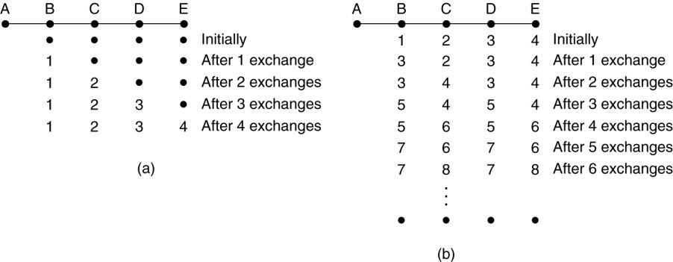
Distance Vector Routing (2)
The count-to-infinity problem.

Slide 16
Link State Routing
Each router must do the following:
Discover its neighbors, learn their network address.
Measure the delay or cost to each of its neighbors.
Construct a packet telling all it has just learned.
Send this packet to all other routers.
Compute the shortest path to every other router.

Slide 17
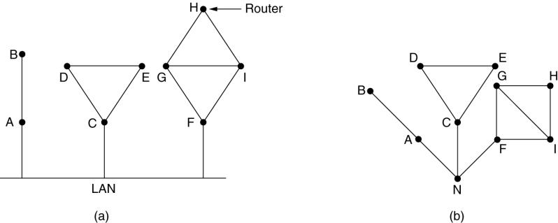
Learning about the Neighbors
(a) Nine routers and a LAN. (b) A graph model of (a).

Slide 18
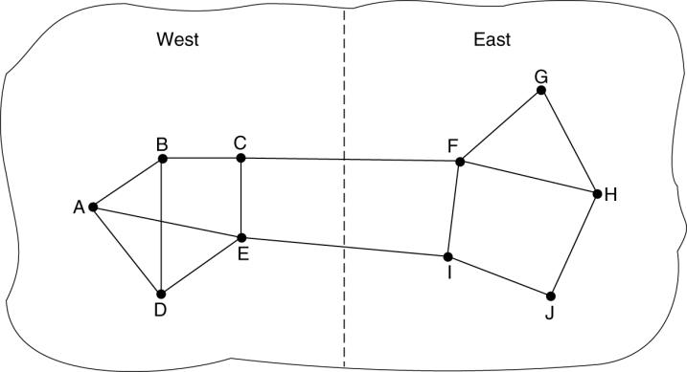
Measuring Line Cost
A subnet in which the East and West parts are connected by two lines.

Slide 19
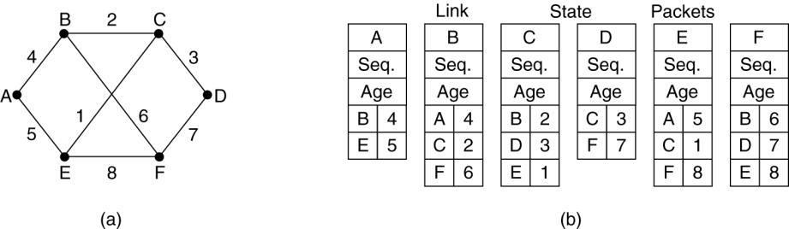
Building Link State Packets
(a) A subnet. (b) The link state packets for this subnet.

Slide 20
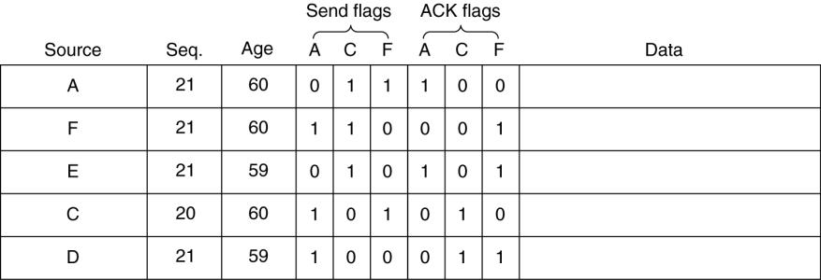
Distributing the Link State Packets
The packet buffer for router B in the previous slide (Fig. 5-13).

Slide 21
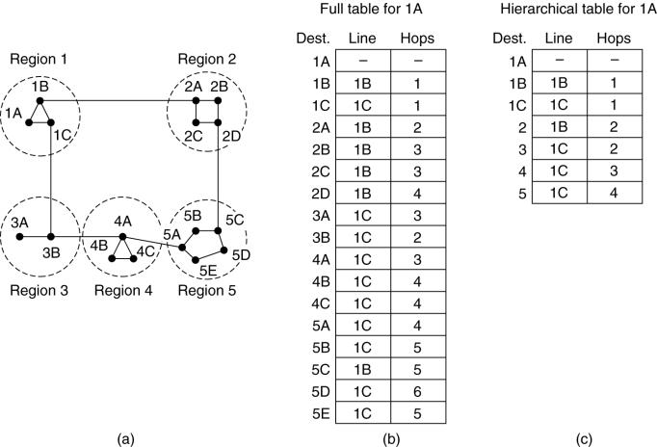
Hierarchical Routing
Hierarchical routing.

Slide 22
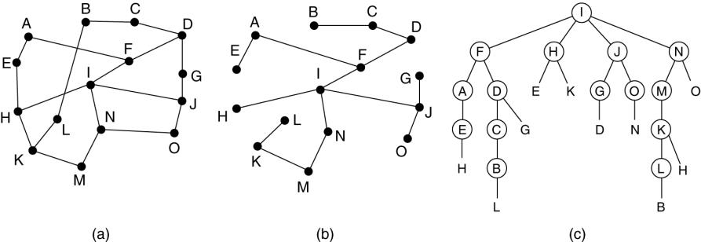
Broadcast Routing
Reverse path forwarding. (a) A subnet. (b) a Sink tree. (c) The tree built by reverse path forwarding.

Slide 23
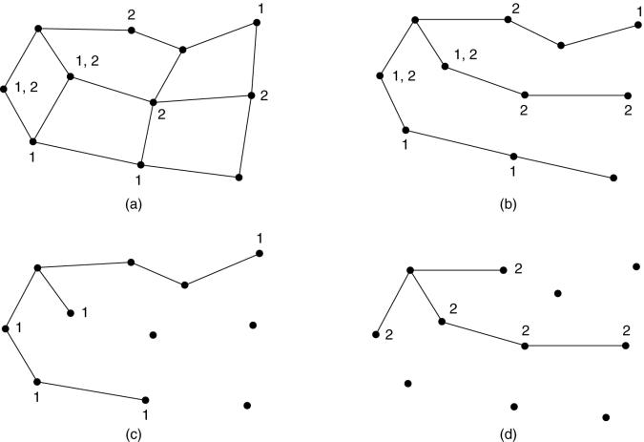
Multicast Routing
(a) A network. (b) A spanning tree for the leftmost router.
(c) A multicast tree for group 1. (d) A multicast tree for group 2.

Slide 24
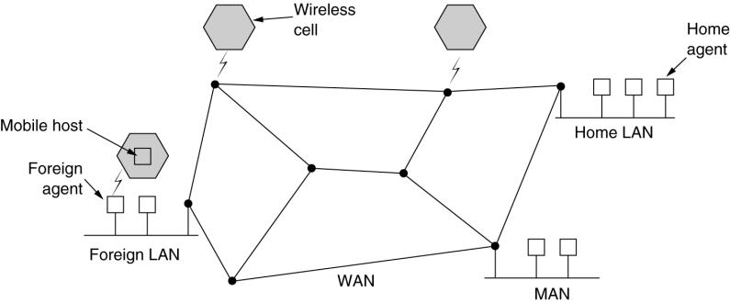
Routing for Mobile Hosts
A WAN to which LANs, MANs, and wireless cells are attached.

Slide 25
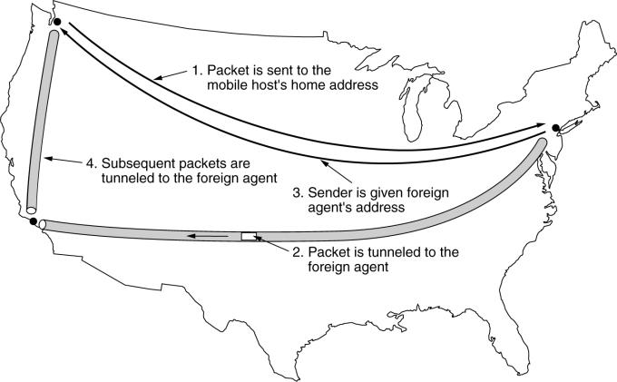
Routing for Mobile Hosts (2)
Packet routing for mobile users.

Slide 26
Routing in Ad Hoc Networks
Possibilities when the routers are mobile:
Military vehicles on battlefield.
  No infrastructure.
A fleet of ships at sea.
  All moving all the time
Emergency works at earthquake .
  The infrastructure destroyed.
A gathering of people with notebook computers.
  In an area lacking 802.11.

Slide 27
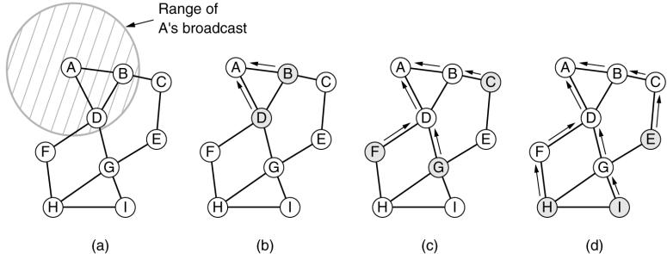
Route Discovery
(a) Range of A's broadcast.
(b) After B and D have received A's broadcast.
(c) After C, F, and G have received A's broadcast.
(d) After E, H, and I have received A's broadcast.
Shaded nodes are new recipients. Arrows show possible reverse routes.

Slide 28
Route Discovery (2)
Format of a ROUTE REQUEST packet.

Slide 29

Route Discovery (3)
Format of a ROUTE REPLY packet.

Slide 30
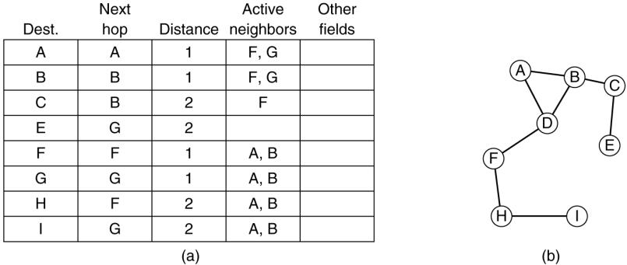
Route Maintenance
(a) D's routing table before G goes down.
(b) The graph after G has gone down.

Slide 31
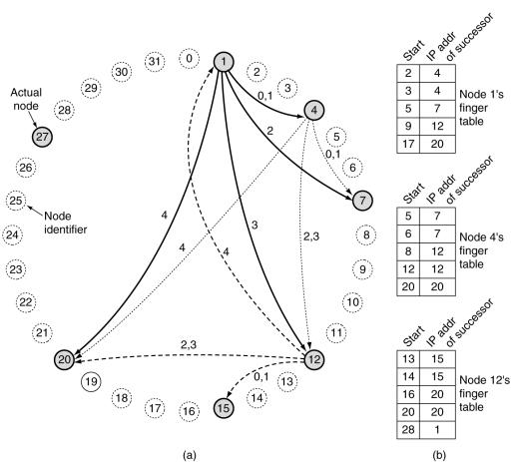
Node Lookup in Peer-to-Peer Networks
(a) A set of 32 node identifiers arranged in a circle. The shaded ones correspond to actual machines. The arcs show the fingers from nodes 1, 4, and 12. The labels on the arcs are the table indices.
(b) Examples of the finger tables.

Slide 32
Congestion Control Algorithms
General Principles of Congestion Control
Congestion Prevention Policies
Congestion Control in Virtual-Circuit Subnets
Congestion Control in Datagram Subnets
Load Shedding
Jitter Control

Slide 33
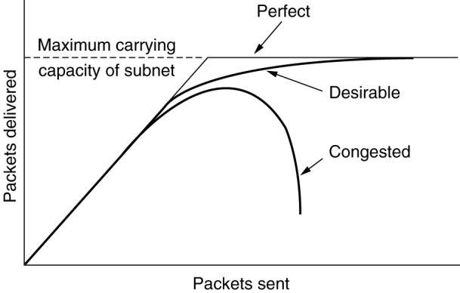
Congestion
When too much traffic is offered, congestion sets in and performance degrades sharply.

Slide 34
General Principles of Congestion Control
Monitor the system .
  detect when and where congestion occurs.
Pass information to where action can be taken.
Adjust system operation to correct the problem.

Slide 35
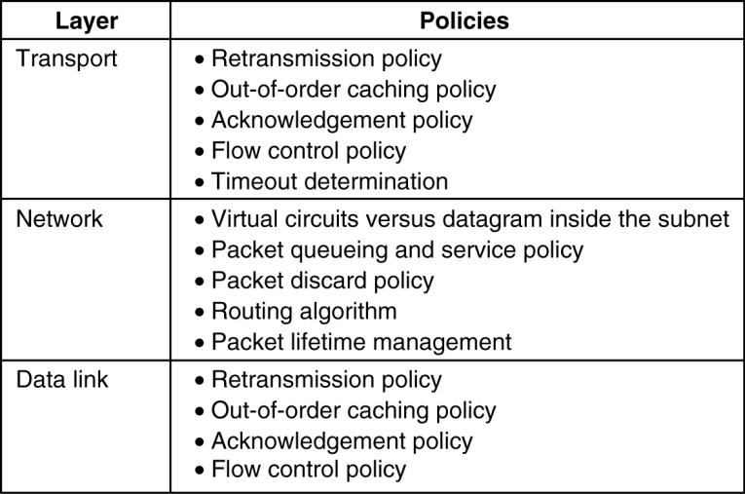
Congestion Prevention Policies
5-26
Policies that affect congestion.

Slide 36
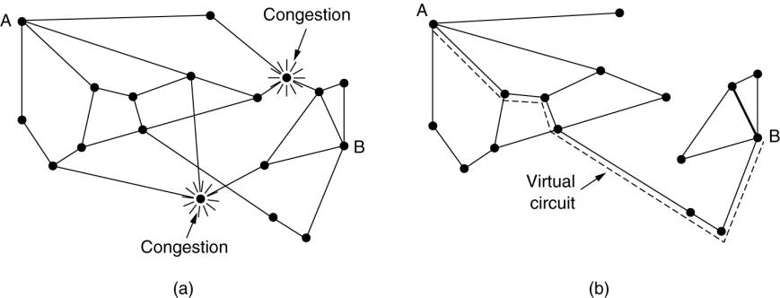
Congestion Control in Virtual-Circuit Subnets
(a) A congested subnet. (b) A redrawn subnet, eliminates congestion and a virtual circuit from A to B.

Slide 37
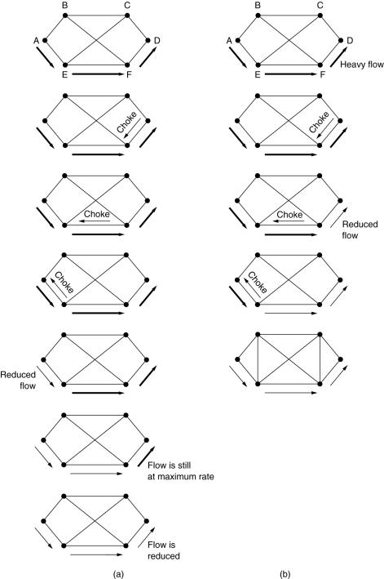
Hop-by-Hop Choke Packets
(a) A choke packet that affects only the source.
(b) A choke packet that affects each hop it passes through.

Slide 38
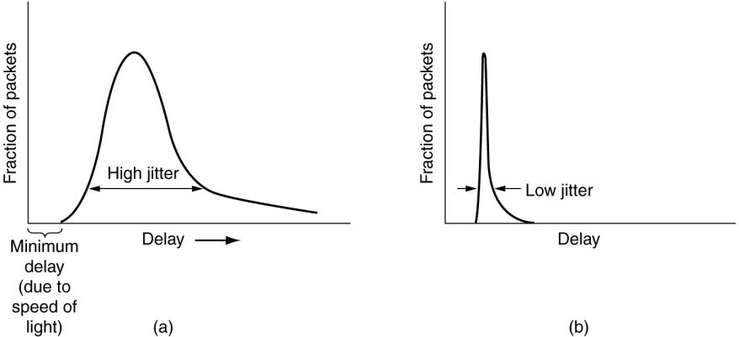
Jitter Control
(a) High jitter. (b) Low jitter.

Slide 39
Quality of Service
Requirements
Techniques for Achieving Good Quality of Service
Integrated Services
Differentiated Services
Label Switching and MPLS

Slide 40
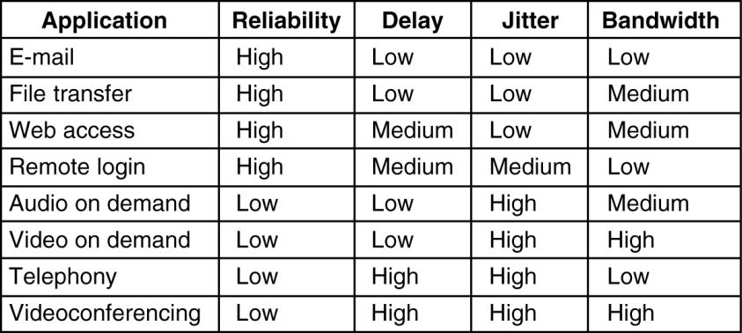
Requirements
5-30
How stringent the quality-of-service requirements are.

Slide 41
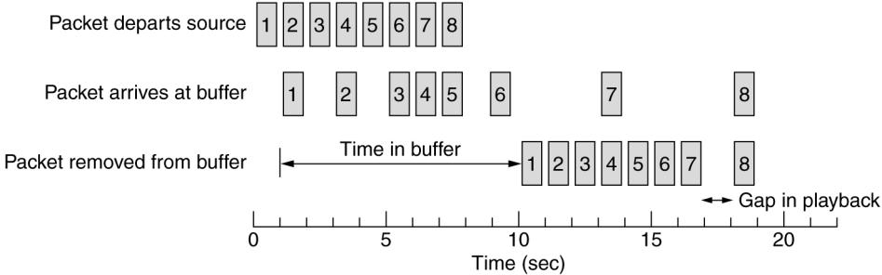
Buffering
Smoothing the output stream by buffering packets.

Slide 42
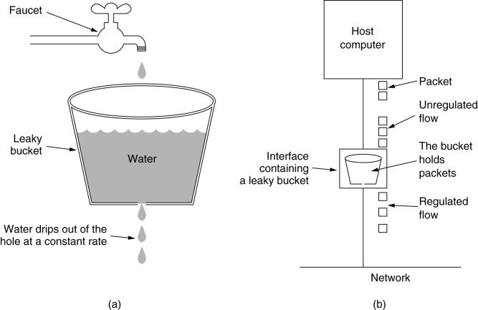
The Leaky Bucket Algorithm
(a) A leaky bucket with water. (b) a leaky bucket with packets.

Slide 43
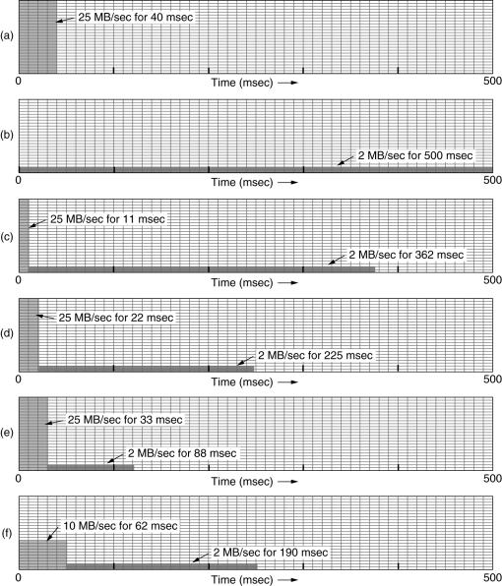
The Leaky Bucket Algorithm
(a) Input to a leaky bucket. (b) Output from a leaky bucket. Output from a token bucket with capacities of (c) 250 KB, (d) 500 KB, (e) 750 KB, (f) Output from a 500KB token bucket feeding a 10-MB/sec leaky bucket.

Slide 44
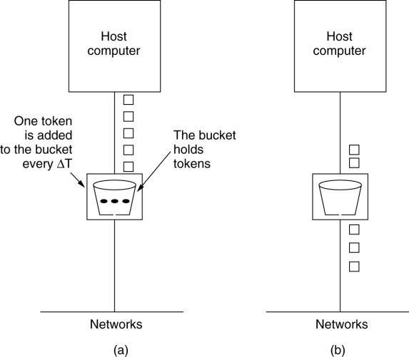
The Token Bucket Algorithm
5-34
(a) Before. (b) After.

Slide 45
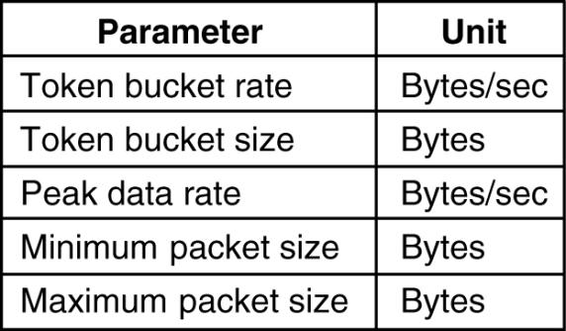
Admission Control
5-34
An example of flow specification.

Slide 46
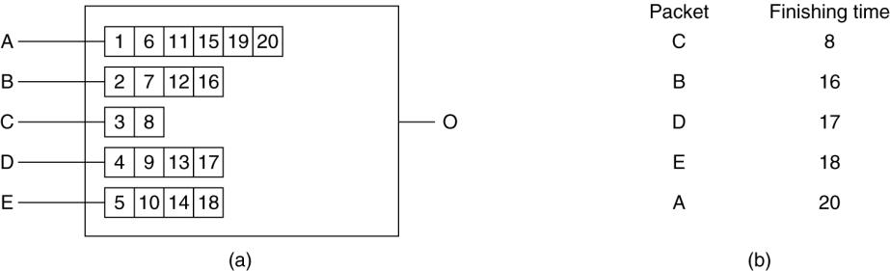
Packet Scheduling
(a) A router with five packets queued for line O.
(b) Finishing times for the five packets.

Slide 47
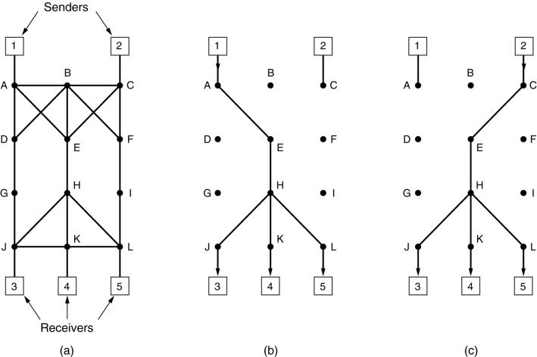
RSVP-The ReSerVation Protocol
(a) A network, (b) The multicast spanning tree for host 1.
(c) The multicast spanning tree for host 2.

Slide 48
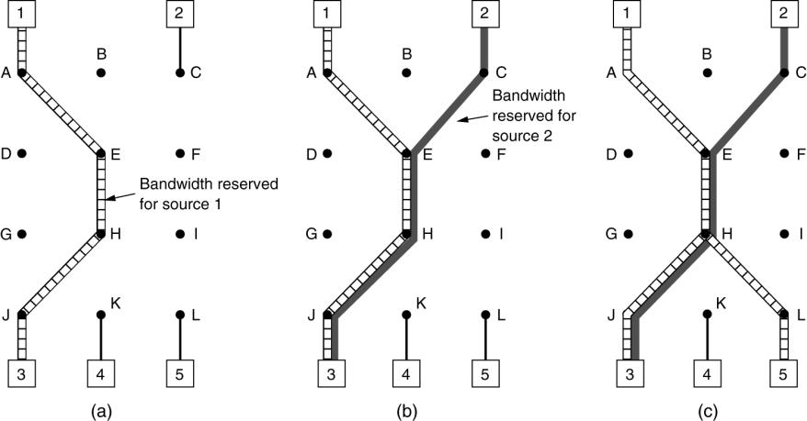
RSVP-The ReSerVation Protocol (2)
(a) Host 3 requests a channel to host 1. (b) Host 3 then requests a second channel, to host 2. (c) Host 5 requests a channel to host 1.

Slide 49
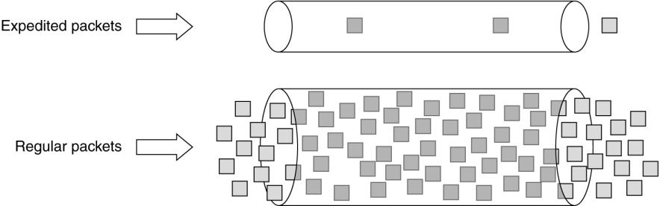
Expedited Forwarding
Expedited packets experience a traffic-free network.

Slide 50
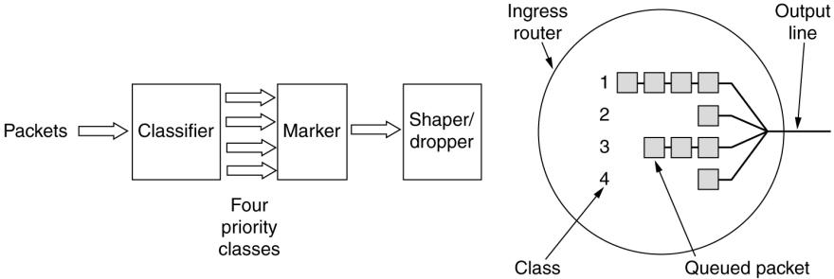
Assured Forwarding
A possible implementation of the data flow for assured forwarding.

Slide 51
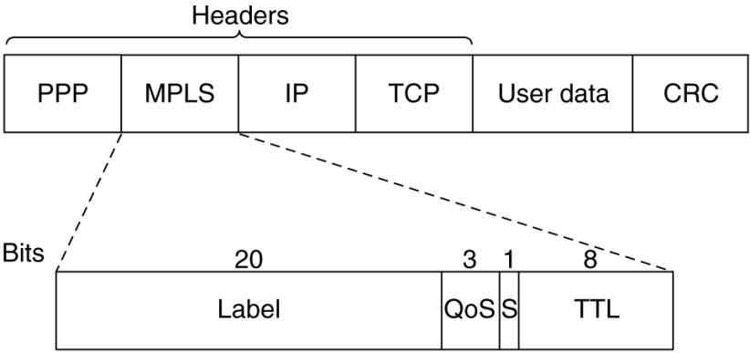
Label Switching and MPLS
Transmitting a TCP segment using IP, MPLS, and PPP.

Slide 52
Internetworking
How Networks Differ
How Networks Can Be Connected
Concatenated Virtual Circuits
Connectionless Internetworking
Tunneling
Internetwork Routing
Fragmentation

Slide 53
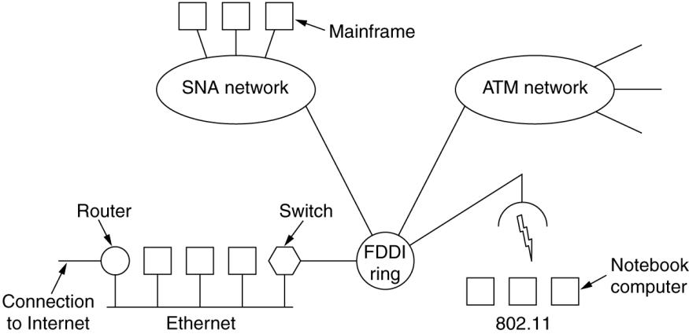
Connecting Networks
A collection of interconnected networks.

Slide 54
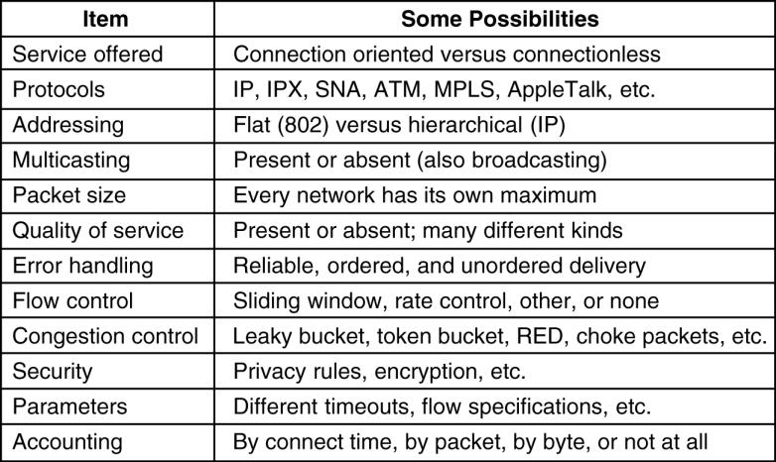
How Networks Differ
5-43
Some of the many ways networks can differ.

Slide 55
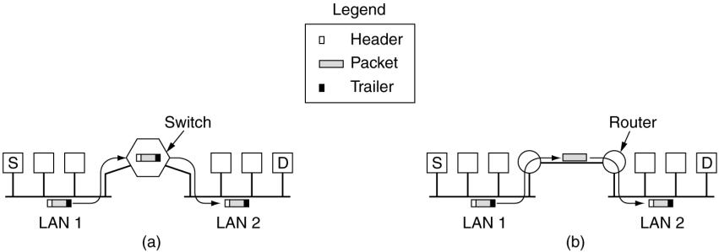
How Networks Can Be Connected
(a) Two Ethernets connected by a switch.
(b) Two Ethernets connected by routers.

Slide 56
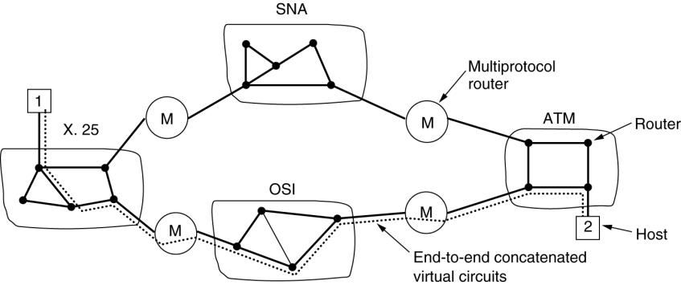
Concatenated Virtual Circuits
Internetworking using concatenated virtual circuits.

Slide 57
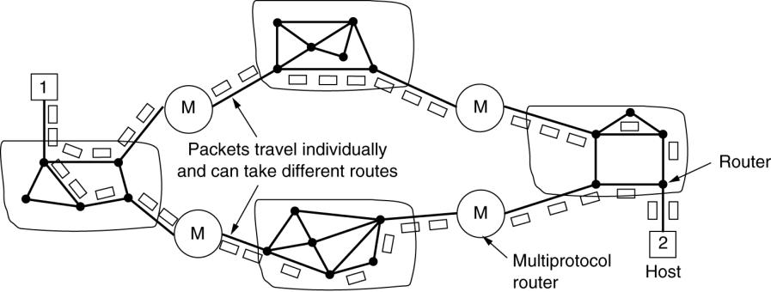
Connectionless Internetworking
A connectionless internet.

Slide 58
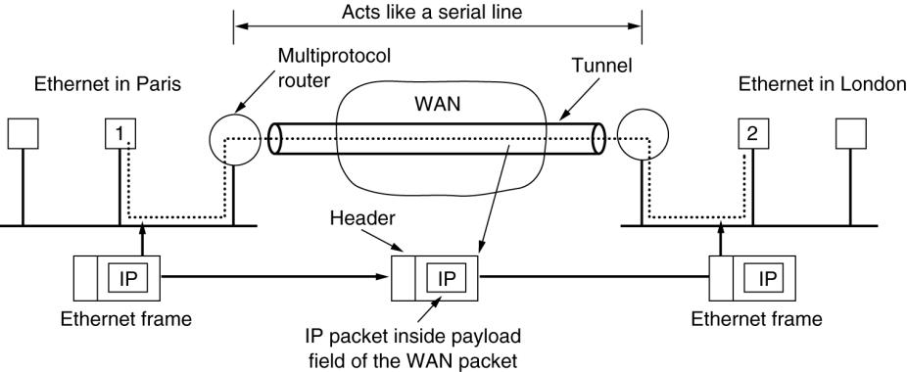
Tunneling
Tunneling a packet from Paris to London.

Slide 59
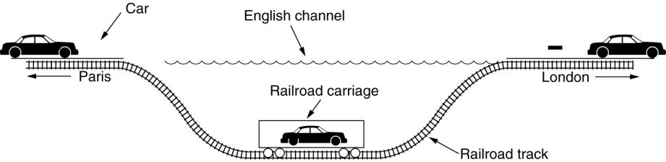
Tunneling (2)
Tunneling a car from France to England.

Slide 60
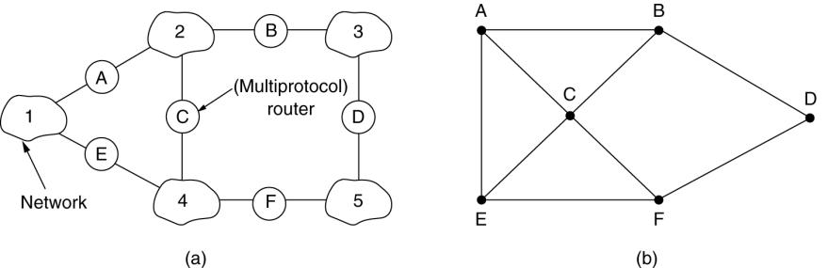
Internetwork Routing
(a) An internetwork. (b) A graph of the internetwork.

Slide 61
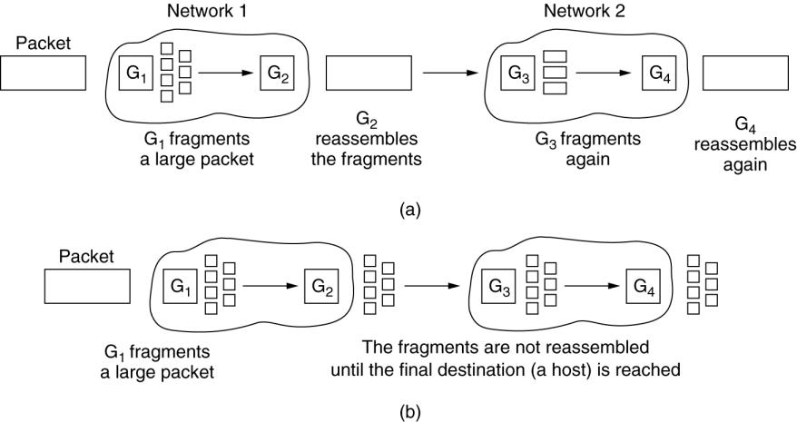
Fragmentation
(a) Transparent fragmentation. (b) Nontransparent fragmentation.

Slide 62
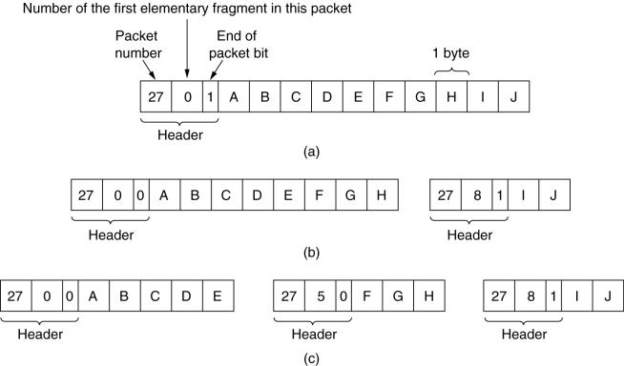
Fragmentation (2)
Fragmentation when the elementary data size is 1 byte.
(a) Original packet, containing 10 data bytes.
(b) Fragments after passing through a network with maximum packet size of 8 payload bytes plus header.
(c) Fragments after passing through a size 5 gateway.

Slide 63
The Network Layer in the Internet
The IP Protocol
IP Addresses
Internet Control Protocols
OSPF – The Interior Gateway Routing Protocol
BGP – The Exterior Gateway Routing Protocol
Internet Multicasting
Mobile IP
IPv6

Slide 64
Design Principles for Internet
Make sure it works.
Keep it simple.
Make clear choices.
Exploit modularity.
Expect heterogeneity.
Avoid static options and parameters.
Look for a good design; it need not be perfect.
Be strict when sending and tolerant when receiving.
Think about scalability.
Consider performance and cost.

Slide 65
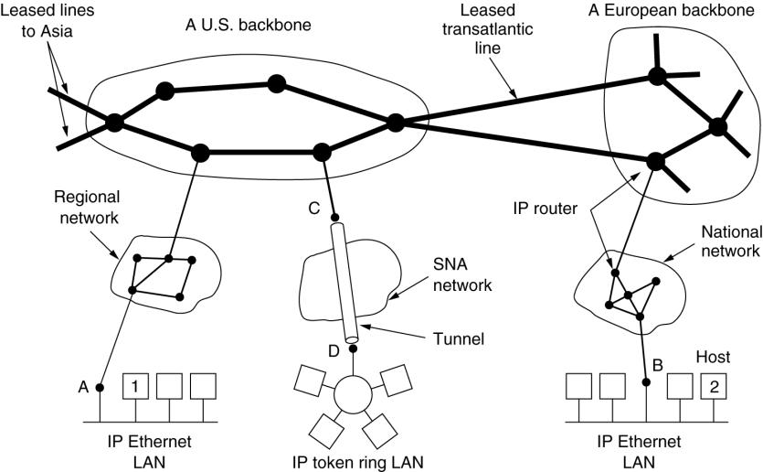
Collection of Subnetworks
The Internet is an interconnected collection of many networks.

Slide 66
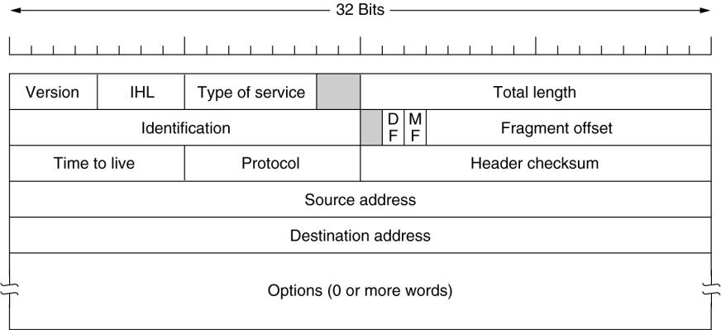
The IP Protocol
The IPv4 (Internet Protocol) header.

Slide 67
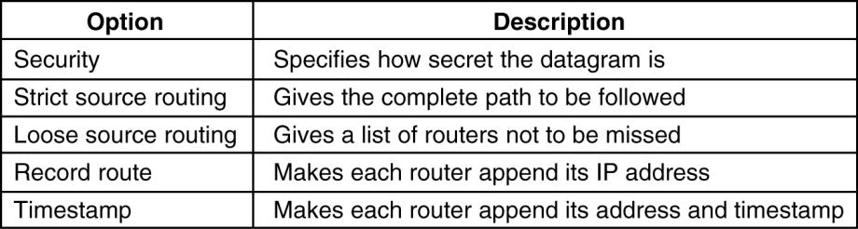
The IP Protocol (2)
5-54
Some of the IP options.

Slide 68
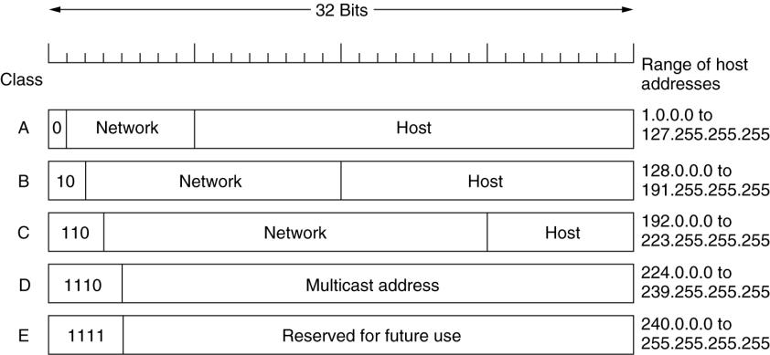
IP Addresses
IP address formats.

Slide 69

IP Addresses (2)
Special IP addresses.

Slide 70

Subnets
A campus network consisting of LANs for various departments.

Slide 71

Subnets (2)
A class B network subnetted into 64 subnets.

Slide 72

CDR – Classless InterDomain Routing
5-59
A set of IP address assignments.

Slide 73

NAT – Network Address Translation
Placement and operation of a NAT box.

Slide 74

Internet Control Message Protocol
5-61
The principal ICMP message types.

Slide 75

ARP– The Address Resolution Protocol
Three interconnected /24 networks: two Ethernets and an FDDI ring.

Slide 76

Dynamic Host Configuration Protocol
Operation of DHCP.

Slide 77

OSPF – The Interior Gateway Routing Protocol
(a) An autonomous system. (b) A graph representation of (a).

Slide 78

OSPF (2)
The relation between ASes, backbones, and areas in OSPF.

Slide 79

OSPF (3)
5-66
The five types of OSPF messeges.

Slide 80

BGP – The Exterior Gateway Routing Protocol
(a) A set of BGP routers. (b) Information sent to F.

Slide 81

The Main IPv6 Header
The IPv6 fixed header (required).

Slide 82

Extension Headers
5-69
IPv6 extension headers.

Slide 83

Extension Headers (2)
The hop-by-hop extension header for large datagrams (jumbograms).

Slide 84

Extension Headers (3)
The extension header for routing.

